Slide 1
Eatright calorie counter application
By hans wiesner

Slide 2
About
The EatRight Calorie Counter application’s goal is to assist the individual user in counting the amount of calories they consume in order to assist them with their doctor’s or dietician’s professional advice. In no way is EatRight attempting to give professional advice, only to make counting the amount of calories from the foods an individual consumes.

Slide 3
Project sponsor’s
Under Armour
AHA – American Heart Association

Slide 4
Business Need
Currently having a dietitian or nutritionist that can give expert advice on what a person should be eating and shouldn’t be eating is great, but now there needs to be an application that allows the user to keep track of what they are eating on their own. The EatRight calorie counter application will give the user the tools to calculate how many calories they are consuming on a daily and weekly basis. This application will also give the dietitians and nutritionists an application to recommend to their patients in order to assist them in living a healthier lifestyle.

Slide 5
Business requirements
The web application will require a server that stores information about the users of the application and access for trainers, dieticians, etc... who want to check up on their client’s well-being.
When a user inputs the foods they are eating, the number of calories must be stored to a database both for themselves to view and their nutritional advisor (if they have one).

Slide 6
Business value
This application gives the user an easy and stress-free option to count the number of calories they consume as well as the option to include their nutritional advisor with the option to view and offer advice to their client as they see needed. This creates a more cohesive interaction between the client and professional realm, making a healthier lifestyle easier to achieve than ever before.

Slide 7
Special issues or constraints
A large amount of foods in the United States Department of Agriculture food composition database (over 200,000), the data needs to be filtered out for proper usage to meet our needs.

Slide 8
Feasibility/payback analysis

Slide 9
Feasibility/payback analysis

Slide 10
Feasibility/payback analysis

Slide 11
Feasibility/payback analysis

Slide 12
Feasibility/payback analysis

Slide 13
Development Costs Planning & Architecture Coding, Web Design Testing Transition and Closeout | Operation/Maintenance Costs Upgrading Software Licensing fees for software Hardware repairs Hardware upgrades/updates Web team salaries Communication charges
Tangible Benefits Increased site advertisement Reductions in web staff Reductions in IT costs | Intangible Benefits Increased market share Increase website recognition Higher quality food data Improved customer service

Slide 14
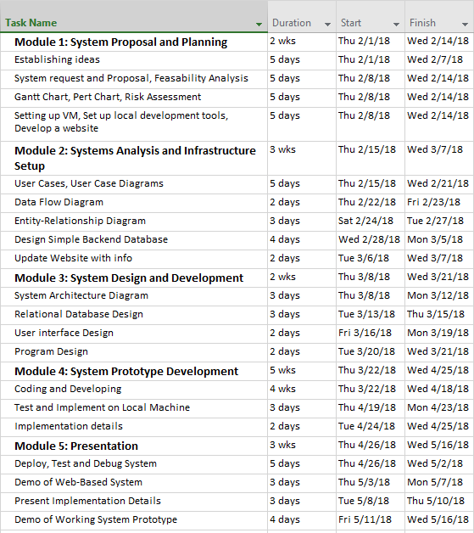
Gantt Chart

Slide 15
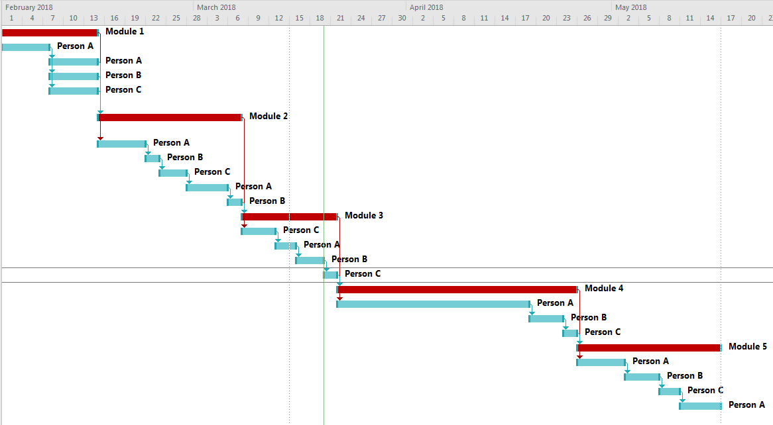
Gantt chart

Slide 16
Pert chart

Slide 17
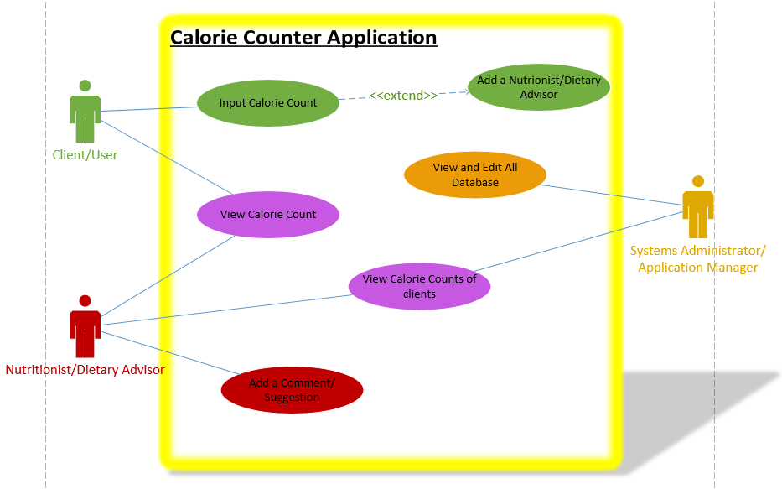
Use case diagram

Slide 18
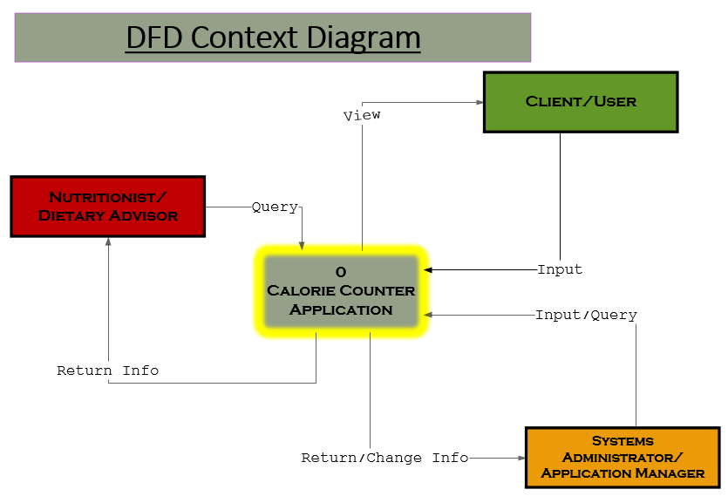
Data flow diagram context

Slide 19
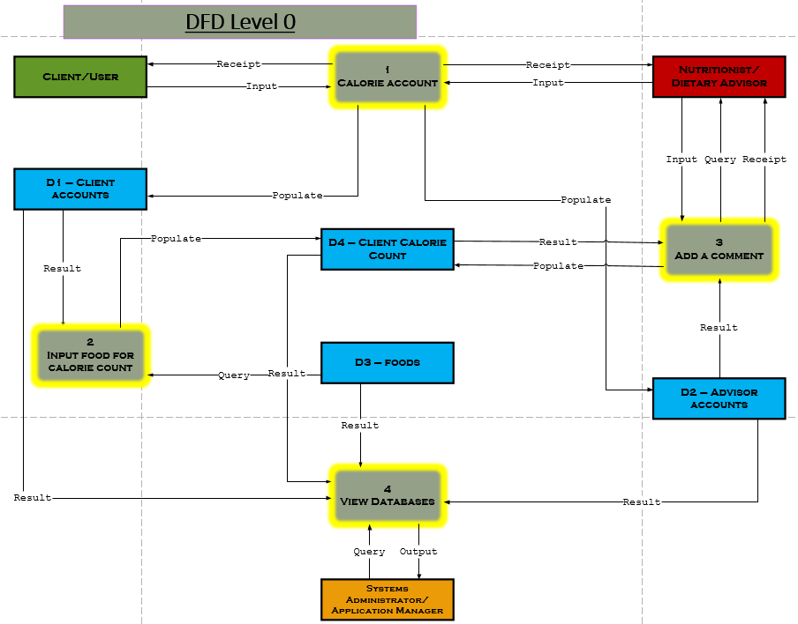
Data flow diagram level 0

Slide 20
Entity relationship diagram

Slide 21
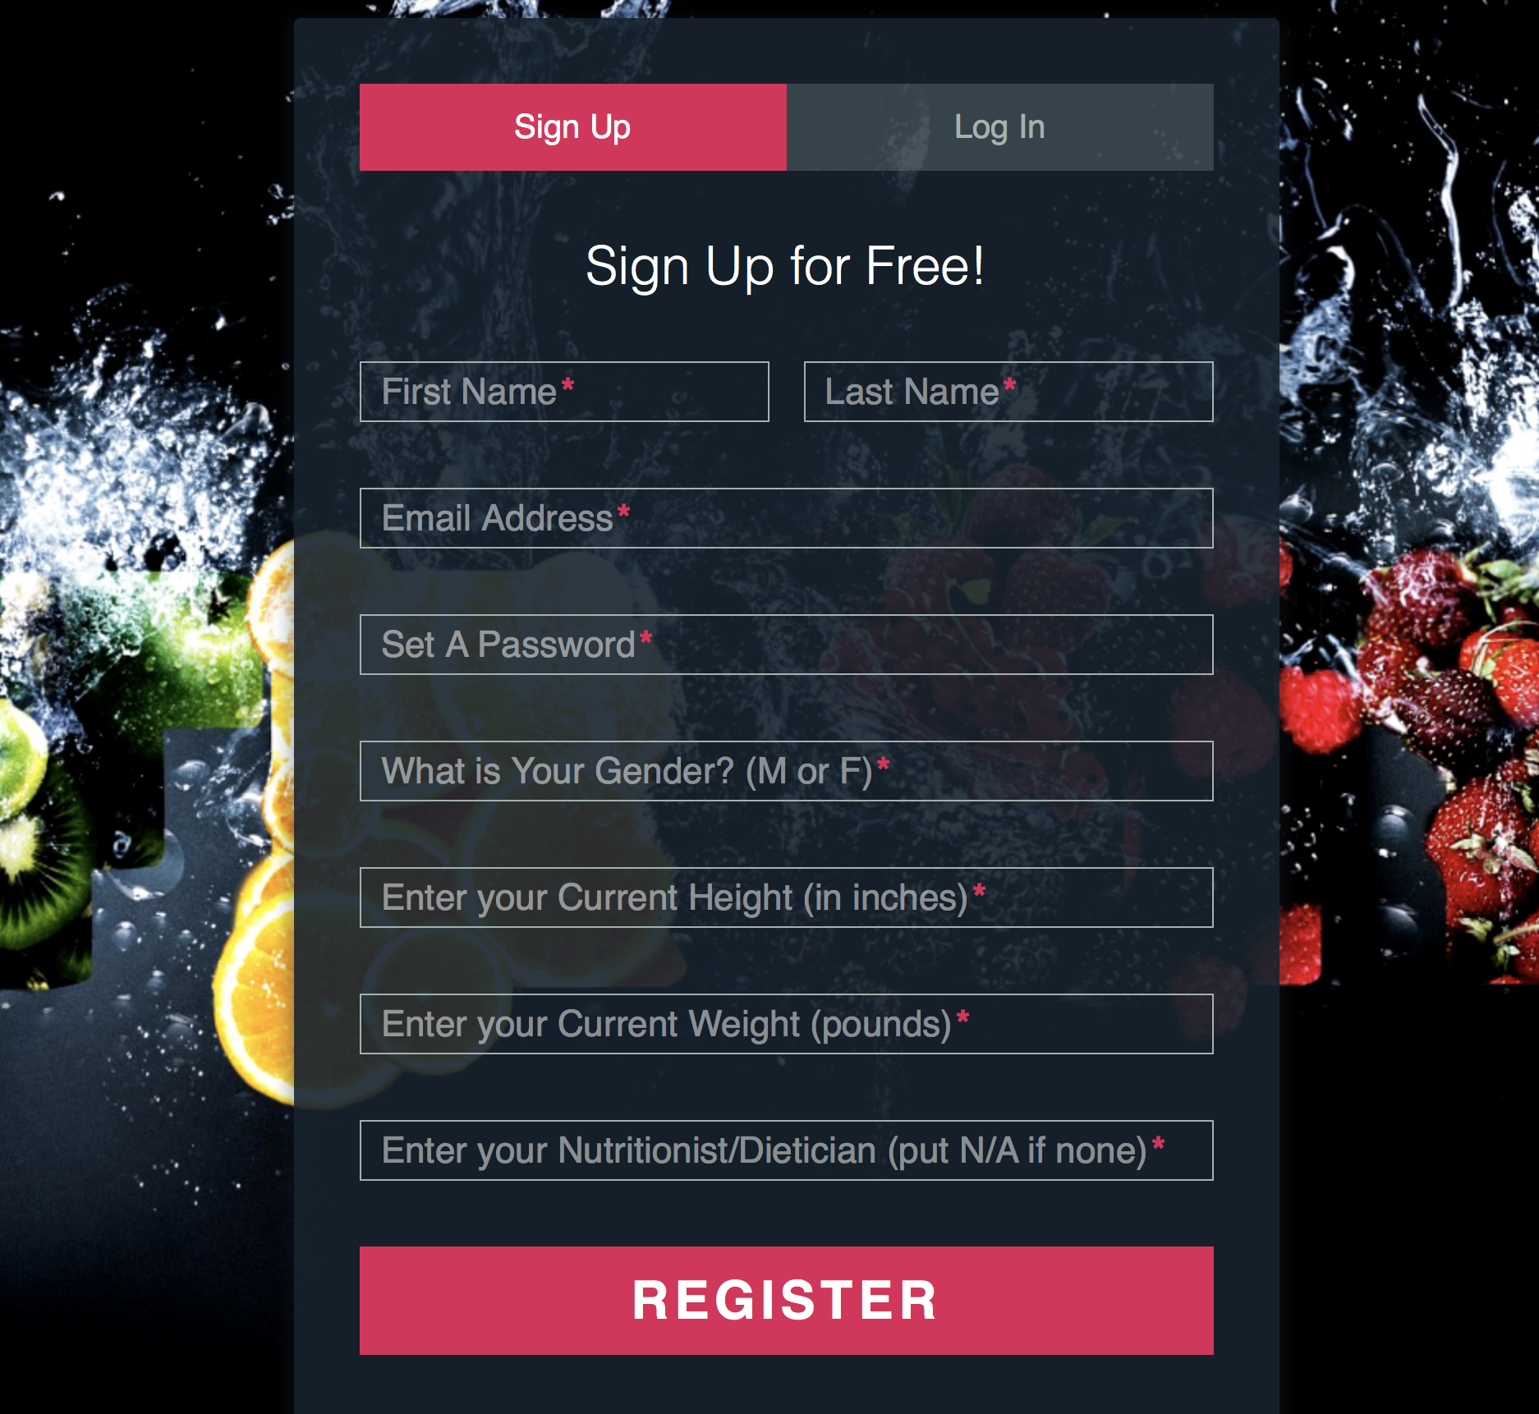
Site demo - register

Slide 22
Site demo – verify email

Slide 23
Site demo – forgot password

Slide 24
Site demo – logging in

Slide 25
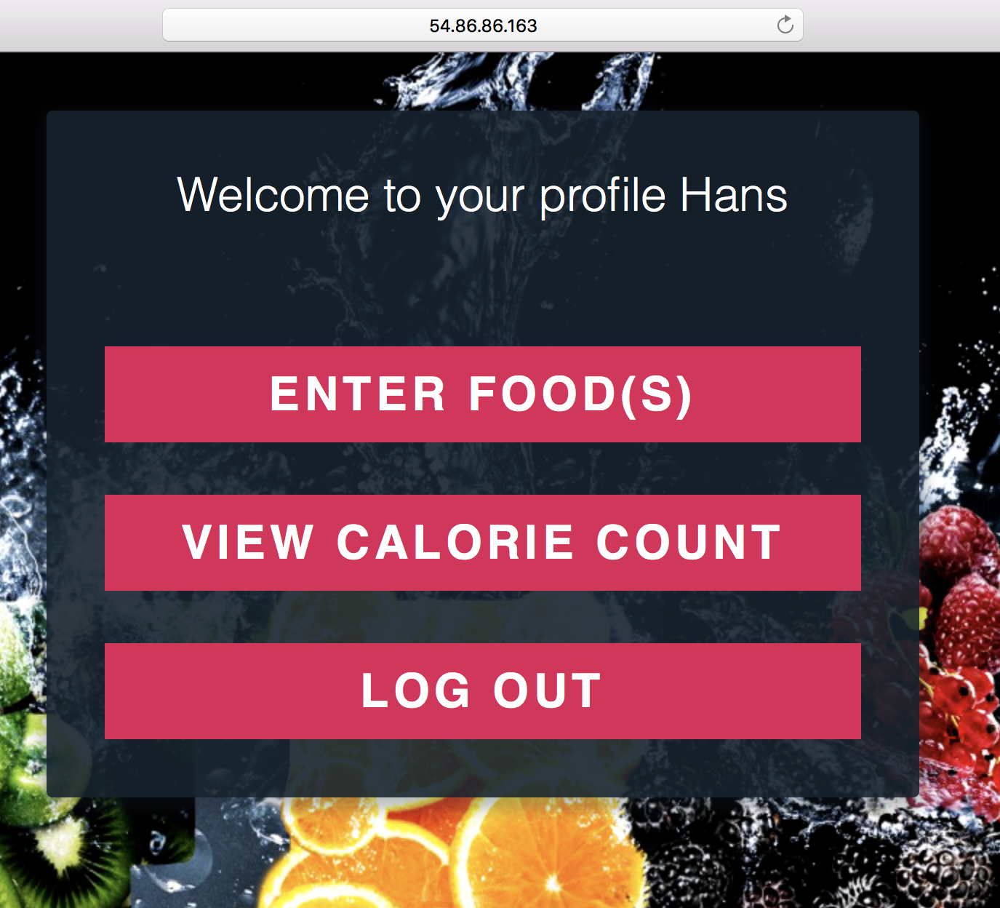
Site demo – profile page

Slide 26
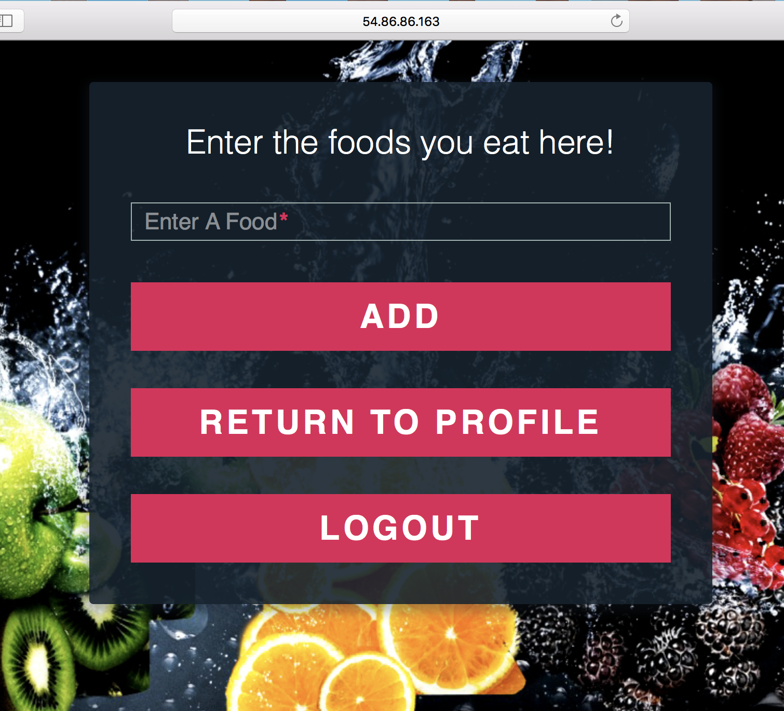
Site demo – adding foods

Slide 27
Site demo – viewing calorie count

Slide 28
Site demo – logging out

